Slide 1
SMART Drum
#GROUP 2

Slide 2
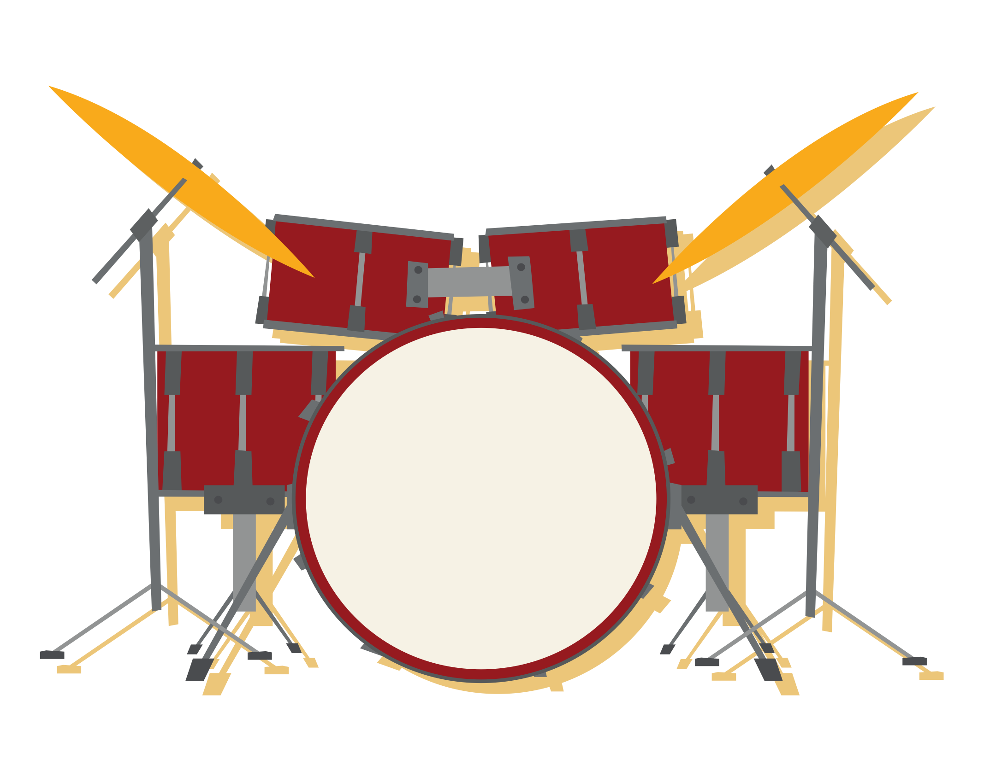

Slide 3
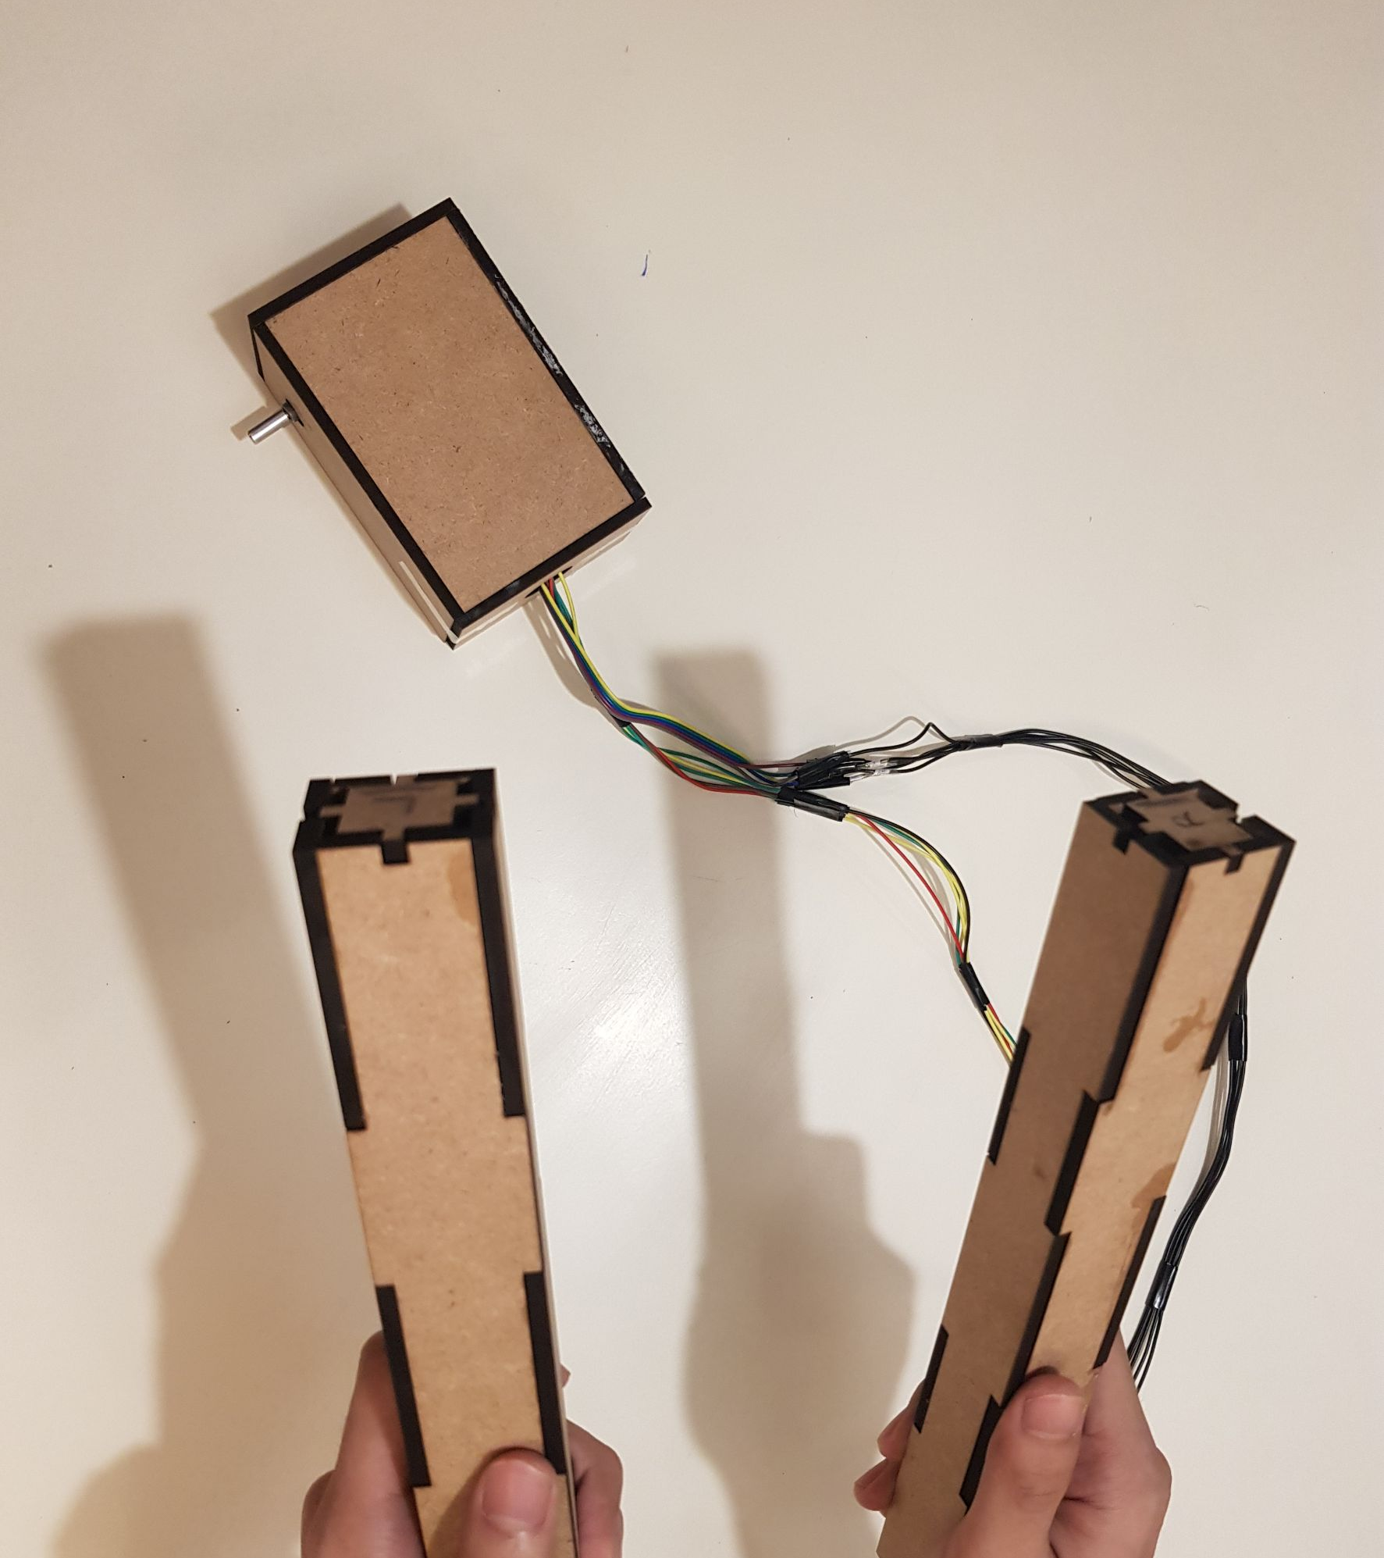
OVERVIEW
Control box
Drumstick

Slide 4
What Smart Drum can do?

Slide 5
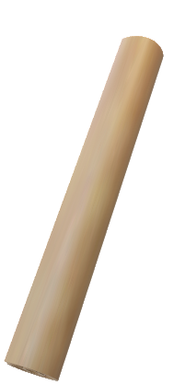
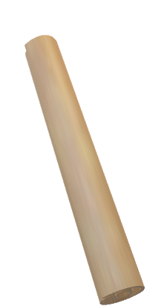

Slide 6


Slide 7
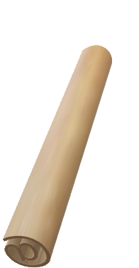

Slide 8


Slide 9
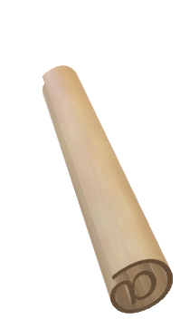

Slide 10
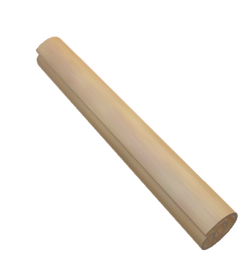

Slide 11
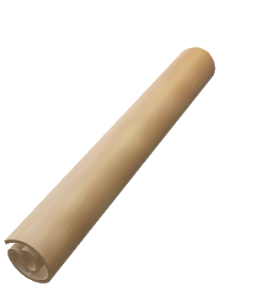

Slide 12
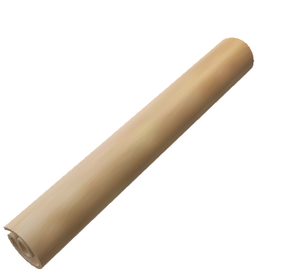

Slide 13
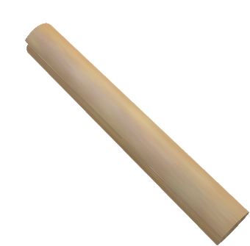

Slide 14


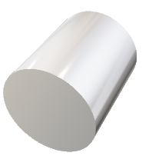

Slide 17
HOW DOES Smart Drum WORK?

Slide 18
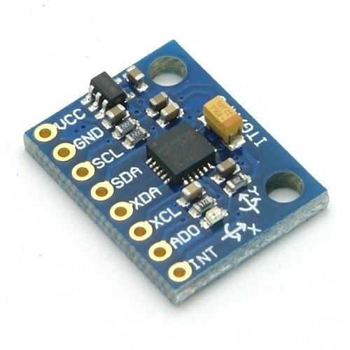
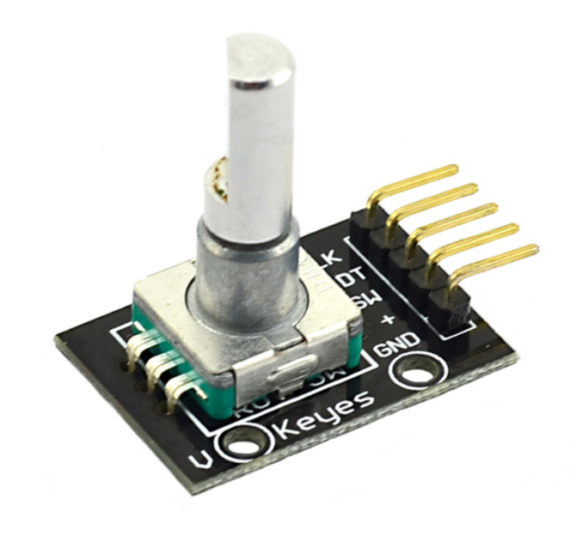
gyroscope
encoder

Slide 19
gyroscope

Slide 20
LET’s Play

Slide 21
THANK YOU

